Slide 1
Deep Reinforcement Learning in Medical Imaging: A Literature Review
S. Kevin Zhoua, Hoang Ngan Leb, Khoa Luub , Hien V. Nguyenc , Nicholas Ayached
Jocelyn baduria
04/21/2021

Slide 2
Table of Contents
Abstract
Introduction
Basics of Reinforcement Learning
Introduction to Deep Reinforcement Learning
DRL in Medical Imaging
Conclusion

Slide 3
Abstract
What is Deep Reinforcement Learning(DRL)?
- It is a subset of Machine Learning called Deep Learning with an implementation
of additional learning process called Reinforcement learning.
What is Deep Learning(DL)?
- Deep learning is one-of-a-kind method of machine learning that uses a layered
neural network learning process in order to learn from data in iterative manner.
What is Reinforcement Learning(RL)?
- It is a learning process that uses a game theory analogy that it learns when it
levels up during the game process through reward system.
DRL is very useful in learning medical images analysis for “object/lesion detection,
surgical image segmentation, registration of significant medical images”.

Slide 4
Introduction
DRL is a (SOTA) State-of-the-Art framework in Artificial Intelligence.
- It scales up the learning sequential decision process and can highly learn with
delayed supervised information.
- It can also deal with maximizing the “non-differentiable” metrics of parametric
setting of classification accuracy problem.
- It also speed up the searching detection process for optimal transformation of
image registration accuracy.
- It improves the memory allocation of high-dimensional images. Small images
can be used in DRL object detection process.
This survey paper expanded its study on many (SOTA) state-of-the-art contents.

Slide 5
Basics of Reinforcement Learning
Markov Decision Process (MDP)
- Is the essential foundation theory of Reinforcement Learning, a process “whose
the conditional probability distribution of future states only depends upon the
present state”.
- The introduction of reward system not only depends on the current state but
also, on the action that leads to future state.
- One good example of this is the famous online game “Fortnite”. Usually, the game
player chooses an action while playing according to the set of rules and the
environment receives the action and produces a reward. Then the player transfers to
the next level until he/she reached the final level of the game which is the future state.

Slide 6
Basics of Reinforcement Learning
MDP is defined into five elements:
set of state/observation space
set of actions the agents can choose from
transition probability function
reward function
discount factor
The main objective of (RL) Reinforcement Learning is to find the prime rules or
best- known solution that gives the highest “expected cumulative reward
called return - the weighted sum of immediate rewards”.

Slide 7
Basics of Reinforcement Learning
Reinforcement Learning is divided into two functions
1. Model-Free Methods
- This method is the learning process of a gamer during the interaction process
with other players and the environment to exceed the maximum policy.
2. Model-Based Methods
- This method is when the experienced gamer knows such a certain rules or
game policy and use it for its own advantage to exceed the maximum policy.

Slide 8
Introduction to Deep Reinforcement Learning
Autoencoder
- Is a representation unsupervised learning used for “dimensionality reduction
and feature selection”.
Deep Belief Network and Deep Autoencoders
- Are unsupervised learning used for network initialization.
- Deep autoencoders have one seen input layer and one invisible layer.
- Deep belief network is based on “Restricted Boltzmann Machines” which
contains of layered input data and a layered invisible units that can gain a
knowledge to describe the features that are gathered from the “higher-order of
correlations in the data”.

Slide 9
Introduction to Deep Reinforcement Learning
Multi-layer Perceptron (MLP)
- Neuron is the simplest form of neural network.
- Perceptron is a computational single form of neuron that has one or many
inputs, main-processor, and one output.
- There are two types of Neural Networks.
1. Convolutional Neural Networks (CNN)
2. Recurrent Neural Networks (RNN)
Convolutional Neural Networks (CNN)
- A fully joined multi-layer perceptrons that perform weight sharing during the data
processing in a grid like topology network.

Slide 10
Introduction to Deep Reinforcement Learning
Recurrent Neural Network (RNN)
- A sequential model that performs the same task for each sequence on which the
output depends on the previous task computations.
- Long Short-Term Memory (LSTM) was born to address the issue of the difficulty of
(RNN) training for long-term dependencies. It was abled to maintain the memory that
updates and release its content when it is needed during training process.
- Gated Recurrent Unit (GRU) was proposed recently to improve the process of
capturing dependencies at different time intervals. The difference with LSTM it has no
separate memory cells.

Slide 11

Introduction to Deep Reinforcement Learning
Model-free DRL Algorithms
- There are three approaches for this algorithms namely
1. Value-Based DRL Methods
2. Policy Gradient DRL Methods
3. Actor-Critic DRL Methods
Value-Based DRL Methods
1. Deep Q-Learning Network (DQN)
- Is the popular one among the three. This method directly knows the policy
knowledge from the higher dimension inputs in a deep neural network.
- This uses a regression modelling but with main limitation that Q* values tends to
over-estimate because of max values in MSE loss computation.

Slide 12

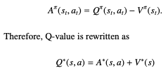
Introduction to Deep Reinforcement Learning
Value-Based DRL Methods
2. Double DQN is the improved DQN version that uses double implementation of DQN.
It addresses the over-estimation issue with its improved estimation but very costly
process although the easiest one method.
3. Dueling DQN addresses the issue of DQN on its value V*, instead of lowering the
value it remembers only the low reward by updating the Q* value. It introduces the
advantage function.

Slide 13
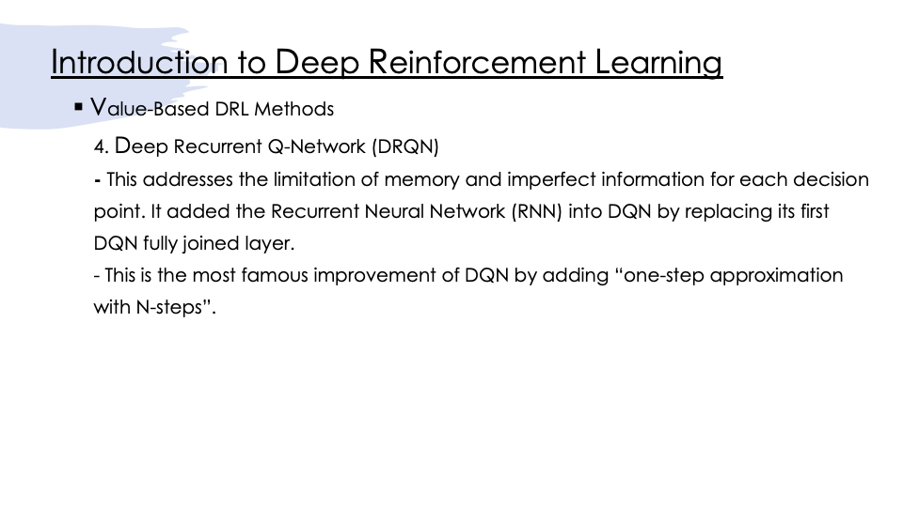

Slide 14
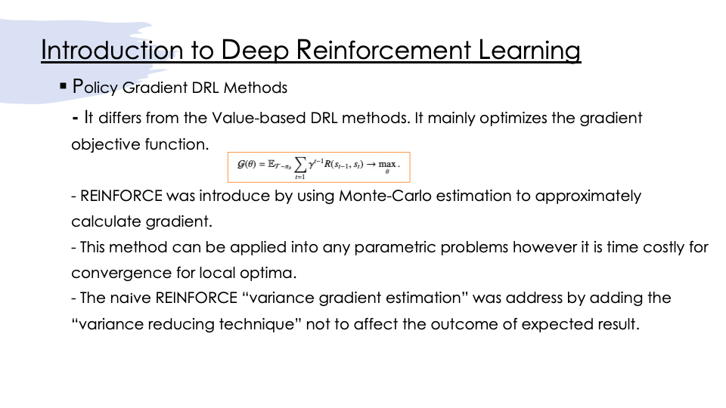

Slide 15
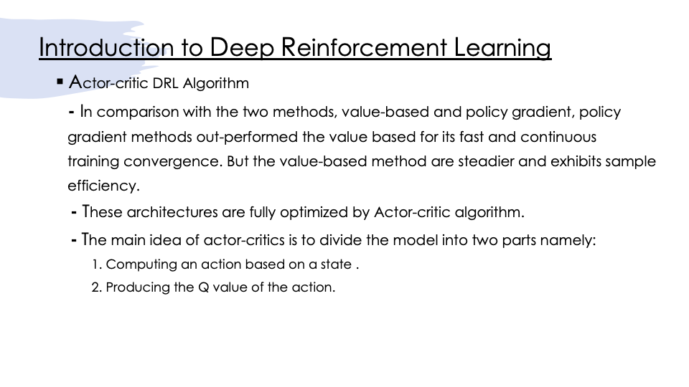

Slide 16
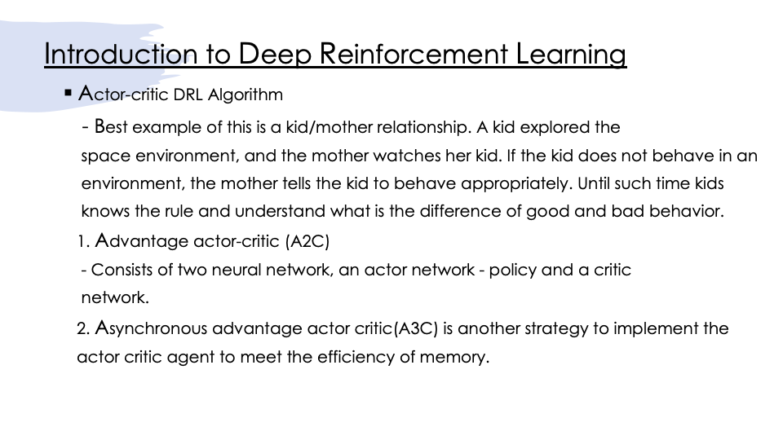

Slide 17
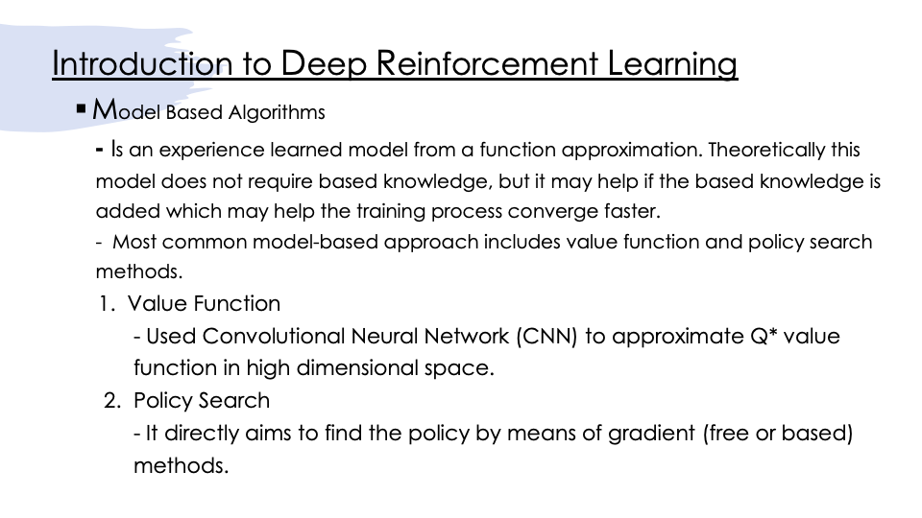

Slide 18
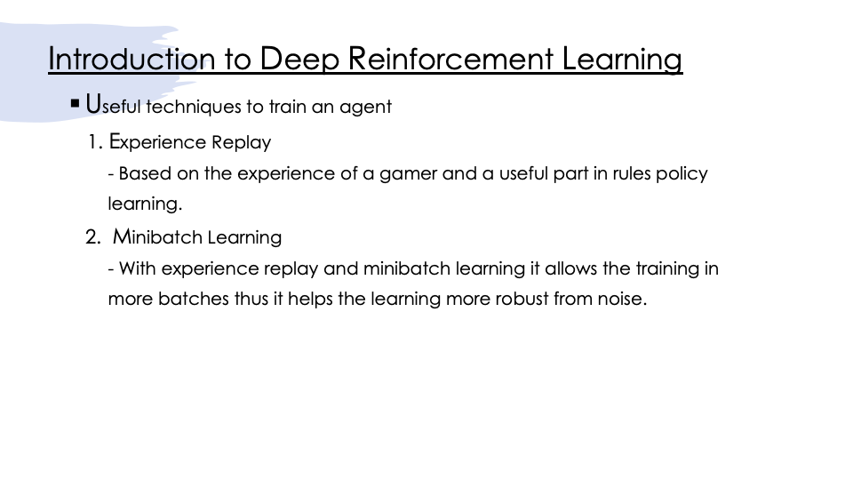

Slide 19
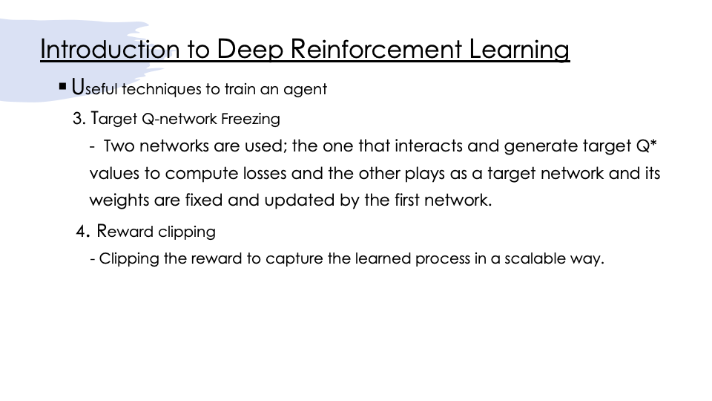

Slide 20
DRL in Medical Imaging
DRL is mostly used in medical imaging analysis.
- Application varies from these field of analysis :
1. Landmark Detection
2. Image Registration, Segmentation
3. Object Lesion localization and classification
4. View Plane localization
5. Plaque Tracking
6. Vessel Extraction
- It is also used in hyperparameter tuning, data augmentation and neural search
architecture.
- Mostly shared non-differentiable optimization for solution.

Slide 21
DRL in Medical Imaging
DRL for parametric Medical Image Analysis
- This model estimated a low dimensional image for analysis.
- There are three elements that is required to formulate a DRL framework.
1. Action
- The agent takes the image by moving the ith parameter independently in
certain value while keeping the other parameters in same position.
2. State
- The state defined in environment is image at certain points – centered position.
3. Reward
- When the target signal is hit or closer the reward function provides a stimuli signal
to the agent.

Slide 22
DRL in Medical Imaging
DRL for parametric Medical Image Analysis
- Once the three elements are available the DQL algorithm was invoked and
triggered to learn the process.
- Then the process learned, the Q-function loss is calculated using the maximum
value.
- Using the greedy search fashion for path supervision it maximizes the reward for
every iteration process.
- This eventually leads to convert the Reinforcement Learning (RL) into Supervised
Learning model. From there we can start learning a model using classification or
regression function.

Slide 23
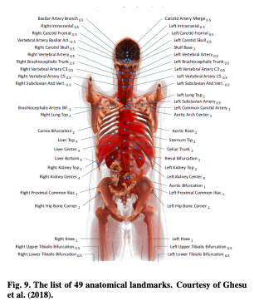
DRL in Medical Imaging
Landmark Detection
- This landmark anatomical structures plays an important
roles in navigating the image sample. It is just like a
travelling geographical landmarks in map.
- It helps the tourist to explore the places they wanted to
visit.
1. Artificial Agent – presents the multi-scale approach for
detection of anatomical landmarks in 3Dimensional space.
It exhibits perfect detection with no false positive and negative values.

Slide 24
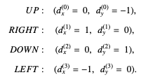
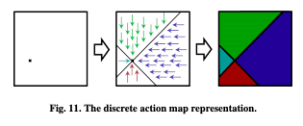
DRL in Medical Imaging
Landmark Detection
2. Supervised action classifier – image partitioning of landmark detection. This is taken
from the path supervision approach.
- This modeling allow four possible action types that helps
to achieve the best result accuracy of image detection
from a “cardiac arrest or obstetric ultrasound image in two
datasets with 1323 and 1642 patients with compared to SOTA - Artificial Agent.
Pixel-wise optimal action step with slopes +/-1 crossing the landmark

Slide 25
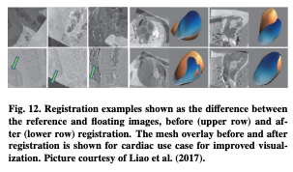
DRL in Medical Imaging
Image Registration
- For comparison in different times and modalities, robust image registration
in medical imaging is needed.
There are two ways used for this modelling.
1. Rigid Registration – It uses a Deep Convolutional Neural Network (DCNN)
that utilizes the path supervision method to end-to-end training.
- This modelling is evaluated into two datasets
(spine – 87 pairs of images, heart - 97 pairs of
images). This artificial agent outperforms
SOTA(State of the Art) methods with big
margin in terms of accuracy and robustness.

Slide 26
DRL in Medical Imaging
Image Registration
1. Rigid Registration
- Updated model using the dueling DQN by learning the Q function instead of path
supervision was introduced to previous method achieves the SOTA when compared
with another model.
2. Non-rigid Registration
- A non-rigid registration comes into full picture when the rigid registration performs an
insufficient transformation between two images.

Slide 27
DRL in Medical Imaging
Image Registration
2. Non-rigid Registration
- Studying the parametric Statistical deformed pair images for an “organ-centered”
MR registered prostate images resulted to better performance when compared to
other SOTA (State of the Art) models. The median DICE coefficients is 0.96 for 2D and
0.88 in 3D. The Q function thus learned from this study.
- This was also concluded when tested with image registration prostate MR data (41
3D images, 8 testing samples resulting to 56 inter-subject image pairs). Both results are
better compared with other state of the art registration model.

Slide 28
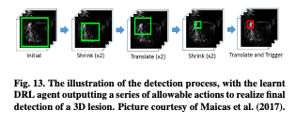
DRL in Medical Imaging
Object/lesion Localization and Detection
- Studies were also concluded for this model for
detecting breast lesions taken from (DCE-MRI)
Dynamic Contrast-Enhanced Magnetic Resonance Imaging machine.
- Bounding box was defined with its actions together with signal reward function
- Deep Q-Learning Network (DQN) is used based on ResNet Architecture.
- Samples were taken from 117 patients with training set 58 patients (annotated 72
lesions ), testing set from 59 patients (69 annotated lesions).
- Accuracy shows similar results with state-of-the-art model but with biggest impact on
speed with time reduced detection.

Slide 29
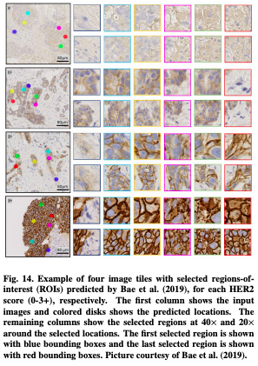
DRL in Medical Imaging
Object/lesion Localization and Detection
- Other studies also took the challenges of big computational
histopathological images of breast cancer classification.
- Pathologist usually selects an abnormal area of the breast
and study its details.
- Such mechanisms captures the attention to improve the
selection and classification of abnormal breast region.
- DRL was used for two task, one for selection and the other one
for classification. Selection is training the certain area of image.
The image selected is used for classification.
- This model achieves its 98% accuracy while consuming only 50%
of the old Pathological method, the attention-based approach.

Slide 30
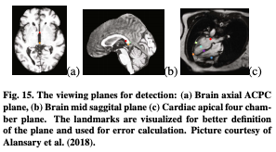
DRL in Medical Imaging
View Plane Localization
- New method proposed for detection of canonical
view in cardiac and MR brain images.
- Studies used the DQN, DDQN, Duel DQN and Duel DDQN.
- A 3D plane is parameterized in 4D vector, with signed reward function and action
steps coarse-to-fine selection.
- Similarly other method added the image augmentation starting warm for better
initialization with active module termination.
- This added approach improves the efficiency and accuracy of plane localization
based on in-house datasets of 430 prenatal 3D ultrasound volume of fetal head.

Slide 31
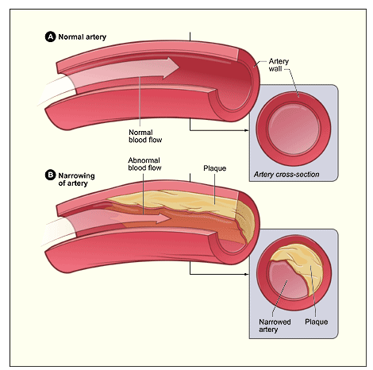
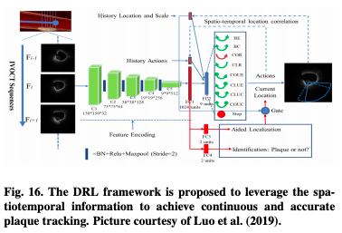
DRL in Medical Imaging
Plaque Tracking
- Plaque Atherosclerosis monitoring is being explored by DRL.
- Plaque is composed of cholesterol, fat, calcium, and other
substances found in the blood. This buildup can lead to
serious health problems or even death.
- Still this proposal is having some challenges due to various intravascular morphology.
Fig A. Plaque

Slide 32
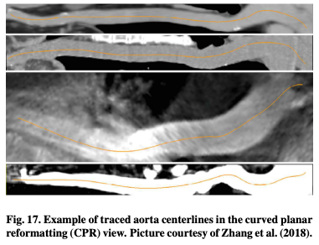
DRL in Medical Imaging
Vessel Centerline Extraction
- DRL using navigation model tracing the vessel centerline.
A point to curve measure is defined in two terms
- Pulls agent position towards the true center label
- The agent is force towards the direction of curve.
- This method achieves good performance compared with 3D CNN supervised
learning.
- The method was updated using DDQN with 3D CNN to improve the centerline
accuracy with speed of 7seconds of inference.

Slide 33
DRL in Medical Imaging
Solving Optimization using DRL
- DRL is known to handle “non-differentiable metrics” therefore it is widely used for
optimizations.
1. Tuning Hyperparameter
2. Image Augmentation
3. Image Classification
4. Searching Neural Network for Augmentation

Slide 34
DRL in Medical Imaging
Image Classification
- CNN model integration with question and answering RL-Based method.
- DNN agent asked the patient about the skin disease symptom using CNN visual
information and answers.
- DNN learned from this method based on question and answering the patient.
- This approach improves the classification accuracy greater than 20% compared only
to CNN using only visualization.
- It shortened the diagnosis in average time compared to decision tree-based QA
approach.

Slide 35
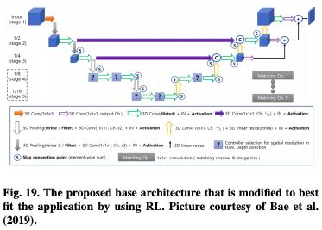
DRL in Medical Imaging
Image Segmentation
- Assigning label to pixels helps in finding the perfect
boundaries of anatomical structure of medical image.
- This method realized the object image segmentation
and mostly used for pre- processing. However, this method is intractable in size and not
yet fully utilized to meet the clinical requirements for 3D image segmentation.
- State of the art proposed NAS (Neural Architecture Search) improves the image
search automation for special application however it is not used often in medical
image segmentation.

Slide 36
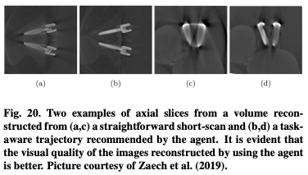
DRL in Medical Imaging
Image Acquisition and Reconstruction
- CT Metal artifacts affects the clinical decision making because of image
inconsistency.
- Using the iterative CT reconstruction helps to solve the optimization issue in medical
image.

Slide 37
DRL in Medical Imaging
Radiotheraphy Planning
- DRL weight tuning policy was leverage in Radiotheraphy planning that takes the
volume histogram as input and outputs the adjusted weight with reward function
sparing the organs at risk.
- This method proposed to improve the radiotherapy planning with yields of quality
score 10.7% higher than human radiotherapy planner.

Slide 38
DRL in Medical Imaging
Miscellaneous Topics
- These topics are for exploration, not related to medical images analysis but
mostly uses based Reinforcement Learning.
1. Video Summarization
2. Surgical gesture segmentation and classification
3. Personalized mobile health intervention
4. Computational model personalization

Slide 39
Conclusion
DRL is powerful model in medical imaging analysis
Successfully applied to various applications in landmark localization, object detection,
image registration and image-based inferencing.
Demonstrated effectiveness in tuning parameter optimization, image augmentation
selection, and Neural Architecture Search (NAS).
Although some methods are not fully utilized in clinical requirement the current DRL
model surpassed my expectations.

Slide 40
Thank You!!!

